Slide 1
Unit 5
Backtracking and Branch and Bound

Slide 2
Introduction
Backtracking and Branch and Bound are the techniques which makes it possible to solve some large instances of difficult combinatorial problems
Both strategies are improvement over exhaustive search

Slide 3
Introduction
Construct solutions one component at a time
Evaluate partially constructed solutions
If a partially constructed solution have potential values which may lead to a solution, then continue. Otherwise remaining components need not be generated
Both methods uses State-Space tree
Branch and Bound is applicable to Optimization problems. But Backtracking does not have this constraint
In Backtracking the tree is developed depth first whereas in Branch and Bound it is developed using best first rule

Slide 4
State-space tree
The root represents the initial state before the search for the solution begins
The nodes of the first level in the tree represent the choices made for the first component of the solution
The nodes of second level represent choices for the second component and so on
The node in the state-space tree is said to be promising if it corresponds to a partially constructed solution that may still lead to a complete solution
If not, it is called non-promising
Leaves represents either non-promising dead ends or complete solution found by the algorithm

Slide 5
Backtracking
Construct solutions one component at a time
Evaluate partially constructed candidate solutions
If a partially constructed solution can be developed further without violating the problem’s constraints take the first remaining legitimate option for the next component.
If there is no legitimate option for the next component, no alternatives for any remaining component need to be considered.
Algorithm backtracks to replace the last component of the partially constructed solution with its next option.

Slide 6
n-Queens Problem
Place n queens on an n-by-n chessboard so that no two queens attack each other by being in the same row or in the same column or on the same diagonal.
For n=1 the problem has a trivial solution.
For n=2 and n=3 there is no solution.
For n = 4 see below

Slide 7
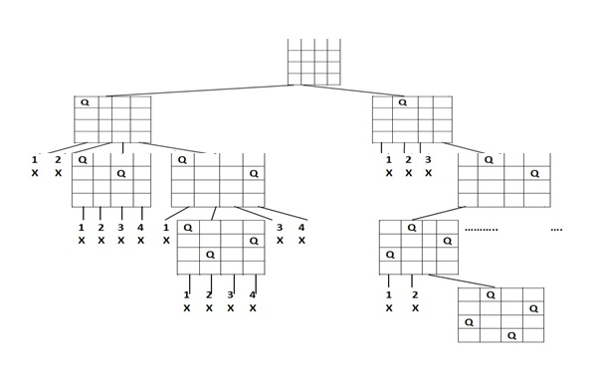
n-Queens Problem

Slide 8
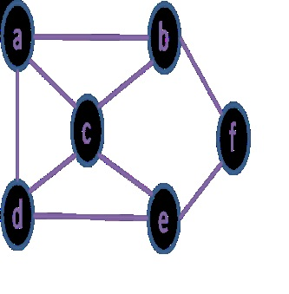
Hamiltonian Circuit Problem
Hamiltonian Circuit Problem
Find a Hamiltonian circuit in a graph.
A path that visits all the graphs vertices exactly once before returning to the starting vertex.
Trace it for the following graph
The state space tree with only one Hamiltonian circuit.

Slide 9
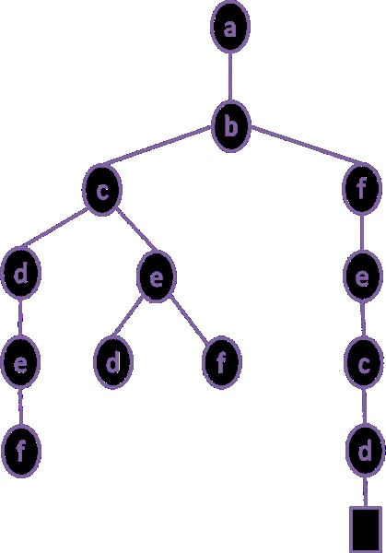

Slide 10
Subset – Sum problem
Find a subset of a given set S = {s1,…,sn} of n positive integers whose sum is equal to a given positive integer d.
Sort the elements in the increasing order - s1 ≤ s2 ≤…… ≤sn.
Record the value of s’ – the sum of these numbers in the node.
If s’ = d the solution to the problem is found.
If s’ ≠ d terminate the node as non-promising if either of the following two inequalities holds
- s‘+ s_{i+1} > d (the sum s’ is too large)
- the sum s’ and the remaining elements < d (sum s’ is too small)
Example
S={3,5,6,7} d = 15

Slide 11
Algorithm Backtrack(x[1..i])
//Gives a template of a generic backtracking algo
//Input: X[1..i] specifies first I promising components of a solution
//Output: All the tuples representing the problem’s solutions
if X[1..i] is a solution write X[1..i]
else
for each element x consistent with X[1..i] and the constraints
do
X[i+1] ←x
Backtrack(X[1..i+1])

Slide 12
General Conclusions on Backtracking
It is applied to difficult Combinatorial Problems for which efficient algorithms are not available
Unlike exhaustive search, at least for some large instances backtracking finds the solution in a faster manner
Even though it is not eliminating the nodes of a state space tree, it finds a way to prune the path if it is not leading to a solution
In the worst case it may be equal to exhaustive search

Slide 13
Branch-and-Bound
It is used for optimization problems
A feasible solution at a point in the problem’s search space satisfies all the problem’s constraints
An optimal solution is a feasible solution with the best value of the objective function
Branch-and-bound requires two additional items compared to backtracking
1. A way to provide a bound on the best value of the objective function on any solution that can be obtained by adding further components to a partially constructed solution represented by the node
2. The value of the best solution seen so far
Compare a node’s bound value with the value of the best solution seen so far.

Slide 14
Branch-and-Bound
If the bound value is not better than the best solution seen so far the node is not promising and can be terminated.
The search path a current node in a state-space tree of a branch-an-bound algo is terminated for any one of the following three reasons
1. The value of the node’s bound is not better than the value of the best solution seen so far.
2. The node represents no feasible solutions because the constraints of the problem are already violated.
3. The subset of feasible solutions represented by the node consists of a single point.

Slide 15
Assignment Problem
Assign n people to n jobs so that the total cost of the assignment is as small as possible.
Process
Find lower bound on the cost of optimal solution
The cost of any solution cannot be smaller than the sum of the smallest elements in each matrix’s rows.
Generate all the children of the most promising node among non-terminated leaves in the current tree. Non-terminated promising leaves are also called live nodes.
Start with the root that corresponds to no elements being selected from the cost matrix.
The nodes on the first level of the tree correspond to selections of an element in the first row of the matrix – a job for person ‘a’.
The nodes on the next level have fixed a job for a and must decide the job for b. The optimal solution will be taken at each level.
The process continues until all jobs have been assigned to all persons.

Slide 16
Knapsack Problem
Given n items of known weights wi and values vi, i =1, 2, …, n and a knapsack of capacity of W, find the most valuable subset of the items that fit in the knapsack.
It is convenient to order the items of a given instance in descending order by their value-to-weight ratios

Slide 17
Knapsack Problem
The first item gives the best payoff per weight unit and the last one gives the worst payoff per weight unit
The upper bound ub is calculated
Ub = v+(W-w)(vi+1/wi+1)
The state-space tree is to be drawn.
The root has the weight and value as 0 since no items have been selected.

Slide 18
Knapsack Problem
Note:
The upper bounds decrease from the first level to the next level.
The upper bounds have to be verified for all leaf nodes (not only at that level).

Slide 19
Travelling Salesman Problem
A reasonable lower bound on tour lengths should be calculated.
One solution
Find the smallest element in the intercity distance matrix D
Multiply it by the number of cities n.
Second solution
For each city i,1≤i ≤n find the sum si of the distances from city i to the two nearest cities
Compute the sum s of these n numbers
Divide the result by 2
If all the distances are integers round up the result to the nearest integer lb

